Slide 1





Beautiful
Melancholy
高 端 水 彩 原 宿 风

Slide 2

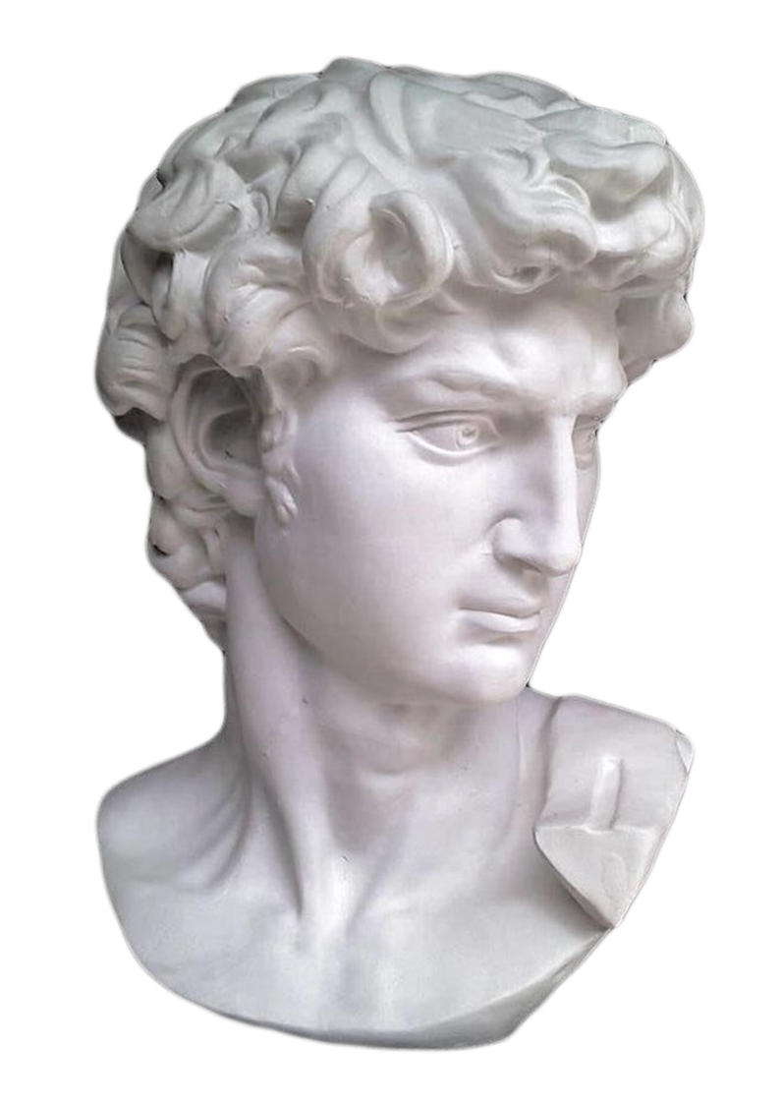
关于我们
About us
The stars are not wanted now:
put out every one; Pack up the moon and dismantle the sun; Pour away
the ocean and sweep up
the wood; For nothing now can
ever come to any good.
塑像
S t a t u e

Slide 3




you emerge from the things, filled with my soul
你像我的灵魂
You are like my soul, a butterfly of dreams
一只梦的蝴蝶
Beautiful
Click here to input the replacement
text and suggest replacing it with this speech.

Slide 4



One word then, one smile, is enough
彼时，一个字，
一个微笑，已经足够
And I'm happy, happy that it's not true
而我会觉得幸福
壹 塑 像
贰 艺 术
叁 金 属
肆 质 感
伍 塑 像
B e a u t I f u l

Slide 5


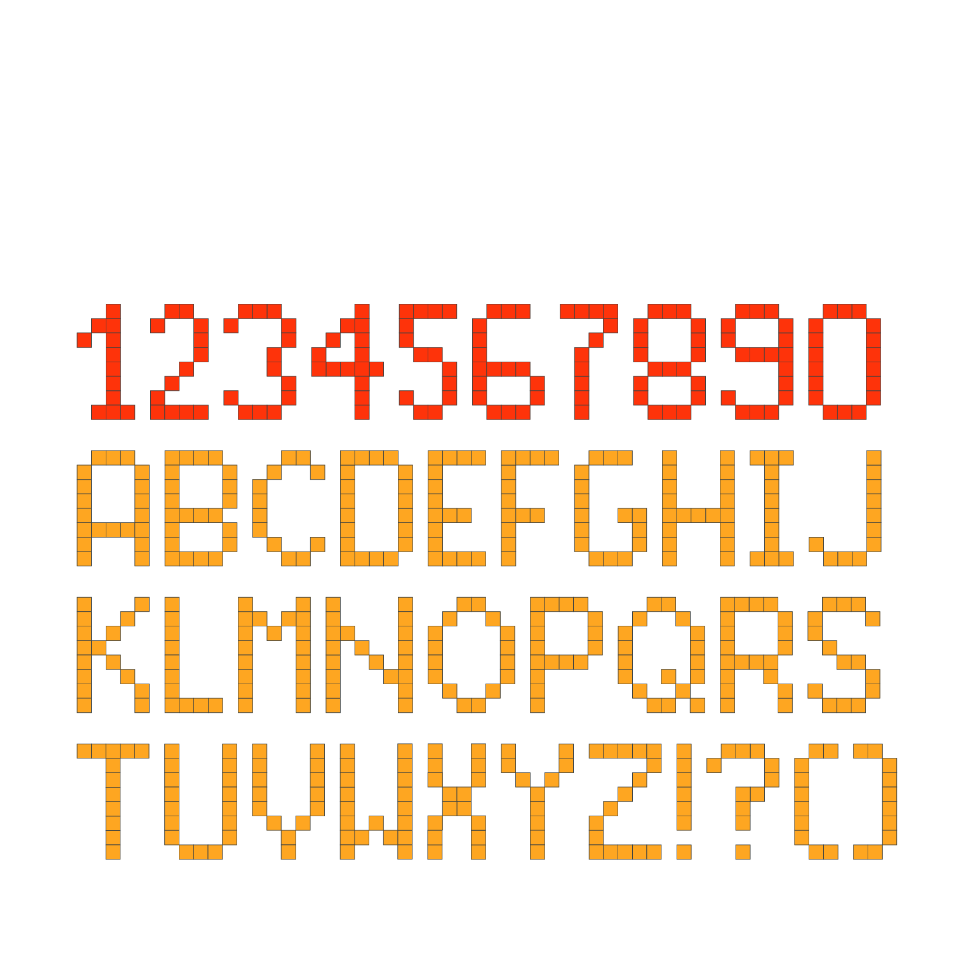
Beautiful
简洁原宿风
The stars are not wanted now:
put out every one; Pack up the moon
and dismantle the sun;
Pour away the ocean and sweep up
the wood; For nothing
now can ever come to any good.
Click here to enter the text
of this section

Slide 6

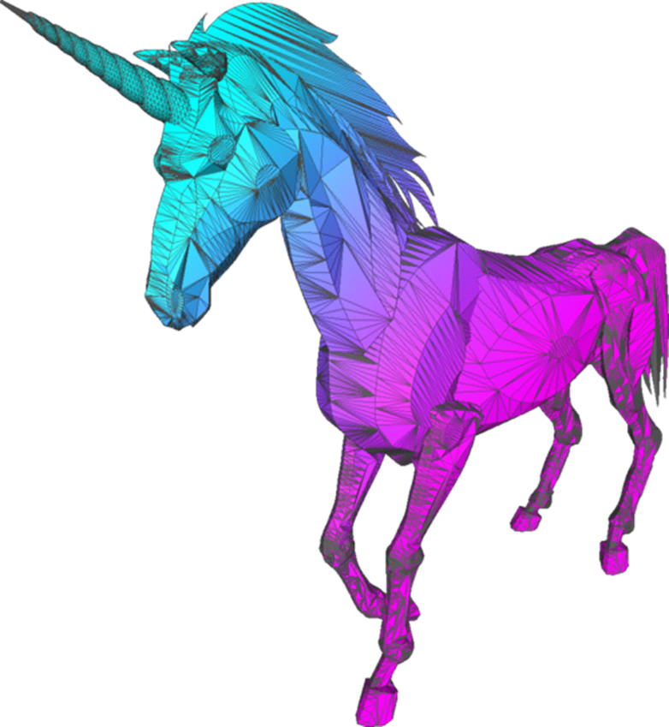
Beautiful
简洁原宿风
The stars are not wanted now:
put out every one; Pack up the moon
and dismantle the sun;
Pour away the ocean and sweep up
the wood; For nothing
now can ever come to any good.

Slide 7

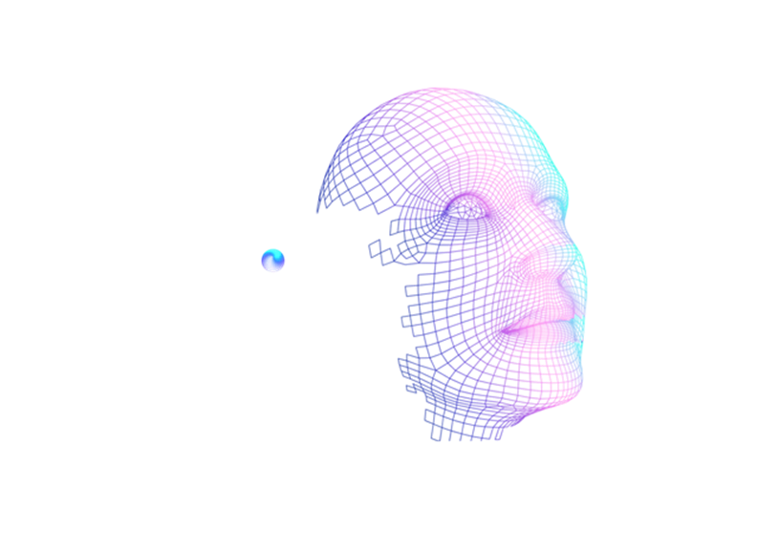


Let me come to be still in your silence
让我在你的沉默中安静无声
And let me talk to you with your silence
并且让我借你的沉默与你说话
简 洁 原 宿 风
B e a u t I f u l

Slide 8




The stars are not wanted now
put out every one; Pack up the moon
and dismantle the sun
Pour away the ocean and sweep
Beautiful
简 洁 原 宿 风
Click here to enter the text of this section

Slide 9




深海
Click here to
enter the text of this section
Beautiful
简 洁 原 宿 风
Click here to enter the text of this section

Slide 10


Beautiful
简洁原宿风
The stars are not wanted now:
put out every one; Pack up the moon
and dismantle the sun;
Pour away the ocean and sweep up
the wood; For nothing
now can ever come to any good.
Click here to enter the text
of this section

Slide 11

One word then, one smile, is enough
彼时，一个字，
一个微笑，已经足够
And I'm happy, happy that it's not true
而我会觉得幸福
Beautiful
Click here to enter the text of this section

Slide 12



you emerge from the things, filled with my soul
你像我的灵魂
You are like my soul, a butterfly of dreams
一只梦的蝴蝶
Melancholy

Slide 13


Melancholy
C l I c k h e r e t o e n t e r
t h e t e x t o f t h I s s e c t I o n
B e a u t I f u l
简 洁 原 宿 风
Click here to enter the text of this section

Slide 14
The stars are not wanted now
put out every one; Pack up the moon
and dismantle the sun
Pour away the ocean and sweep up
the wood; For nothing
now can ever come to any good
Beautiful
简 洁 原 宿 风
Click here to enter the text of this section

Slide 15

Beautiful
简洁原宿风
The stars are not wanted now:
put out every one; Pack up the moon
and dismantle the sun;
Pour away the ocean and sweep up
the wood; For nothing
now can ever come to any good.
Click here to enter the text
of this section

Slide 16

Beautiful
简 洁 原 宿 风
Click here to enter the text of this section
Melancholy

Slide 17


Beautiful
简 洁 原 宿 风
Click here to enter the text of this section
Melancholy
Click here to enter the text of this section

Slide 18
Beautiful
The stars are not wanted now
put out every one; Pack up the moon
and dismantle the sun
Pour away the ocean and sweep up
the wood; For nothing
now can ever come to any good
Melancholy
Click here to input the replacement text and s
uggest replacing it with this speech.

Slide 19
总 结
The stars are not wanted now
put out every one; Pack up the moon
and dismantle the sun
Pour away the ocean and sweep up
the wood; For nothing
now can ever come to any good
Beautiful
简 洁 原 宿 风
Click here to enter the text of this section

Slide 20
感谢
欣赏
Thank you

